Slide 1
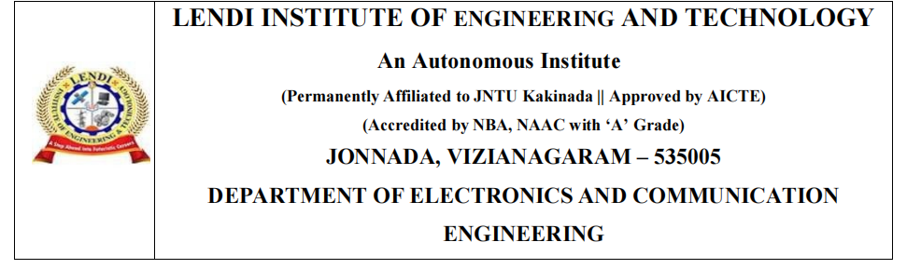
IoT Implementation of Automatic Environment Control for
Indoor Farming
Project Members :-
J. Pravallika 17KD1A0457
Ch. Ganesh Preetham 17KD1A0429
A. Harsha Vardhan 17KD1A0412
Project Guide :-
Dr. B. Kiranmai Ph.D
Professor

Slide 2
CONTENT
Abstract
Aim
Indoor Farming
3.1. What is Indoor Farming ?
4. Block Diagram
5. Components
5.1. NodeMcu ESP8266
5.2. Sensors
5.2.1.LM35
5.2.2.Moisture Sensor
5.3.Dimmer Module
5.4.Cooling fan
5.5.Submersible Water Pump
5.6.Relay
5.7.Incandescent light Source
Software Tools
Circuit Diagram
Conclusion
Future cope

Slide 3
Abstract
Currently, we witness how extreme weather, deteriorating soil and drying lands, collapsing ecosystems that play a crucial role in agriculture making food production harder and harder. As humanity grows larger, space keeps becoming an issue. But we’re beginning to have the larger version of garden farms.
Application of IoT in agriculture could be a life change for humanity and whole planet.
The main purpose of this project is to build a system to monitor the soil moisture and to provide sufficient light and heat artificially through a light source and to control water content automatically.
when low moisture is detected it sends signals to the Arduino platform.

Slide 4
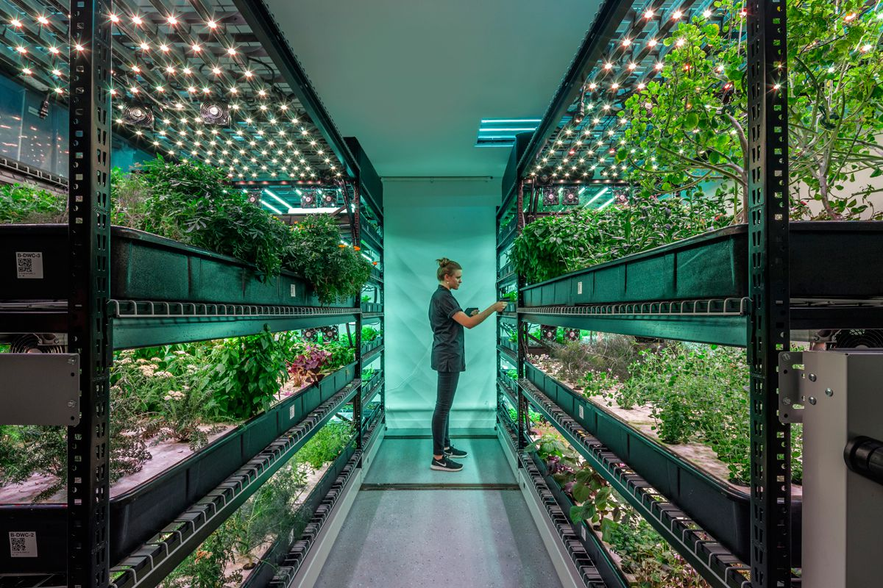
Indoor Farming
What is Indoor Farming ?
Indoor farming is a method of growing crops or plants, usually on a large scale, entirely indoors. This method of farming often implements growing methods such as hydroponics and utilizes artificial lights to provide plants with the nutrients and light levels required for growth.

Slide 5
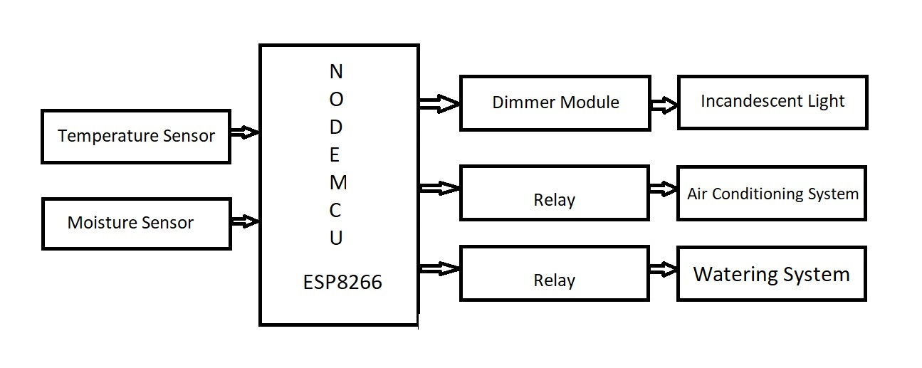
Block Diagram

Slide 6
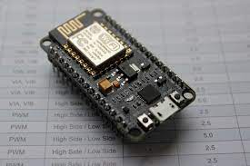
Components
NodeMcu ESP8266
NodeMCU is an open-source LUA based firmware developed for the ESP8266 wifi chip.
Developing NodeMCU with a well-known IDE i.e. Arduino IDE. We can also develop applications on NodeMCU using the Arduino development environment.

Slide 7
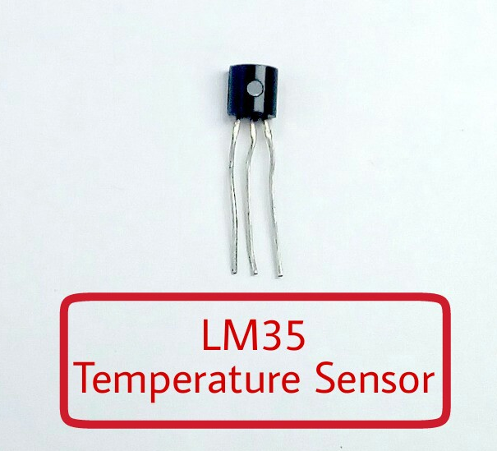
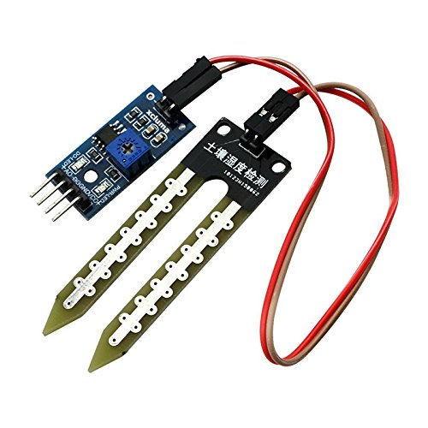
Components
Sensors
LM35(Temperature Sensor)
LM35 is a temperature sensor that can measure temperature in the range of -55°C to 150°C.It is a 3-terminal device that provides an analog voltage proportional to the temperature.
Moisture Sensor
Soil moisture sensors measure the volumetric water content in soil. Since the direct gravimetric measurement of free soil moisture requires removing, drying, and weighing of a sample, soil moisture sensors measure the volumetric water content indirectly by using some other property of the soil, such as electrical resistance, dielectric constant.

Slide 8
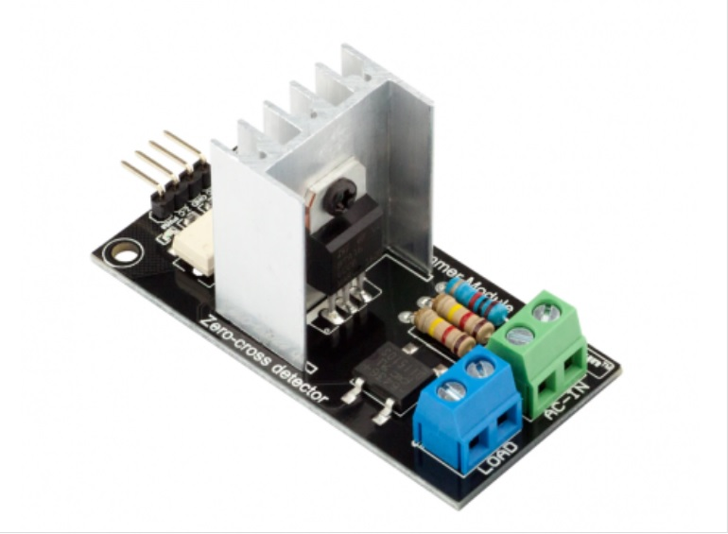
Components
The AC Dimmer is designed to control the alternating current voltage, which can transfer current up to 600V/16А. In most cases, Dimmer is used to turn power ON/OFF for lamps or heating elements, it can also be used in fans, pumps, air cleaners, e.t.c.
The logical level is tolerant to 5V and 3.3V, therefore it can be connected to the microcontroller with 5V and 3.3V level logic.In Arduino, dimmer is controlled with RBDdimmer.h library, which uses external interrupts and process time interrupts.
Dimmer Module

Slide 9
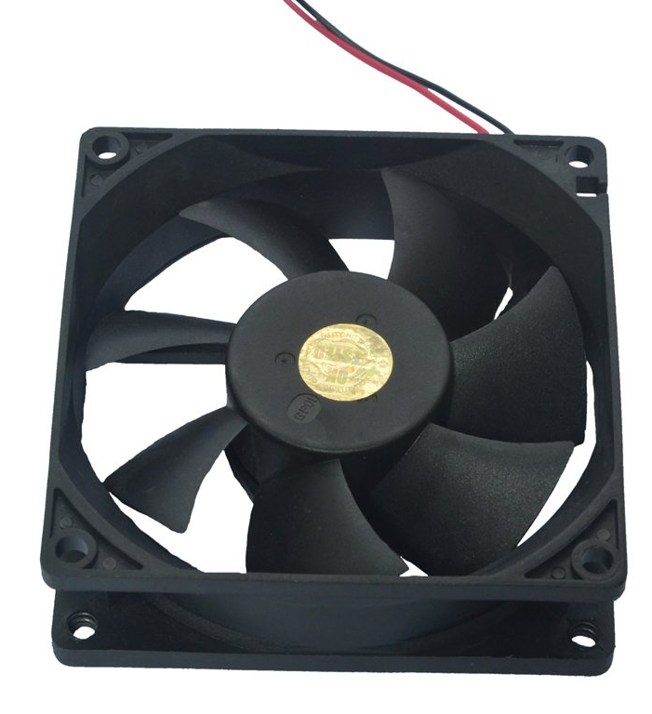
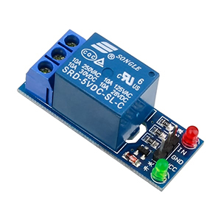
Components
Cooling Fan
We are using Cooling fans to represent the cooling system in the realtime environment. These can be replaced by Air Conditioning System to Contol the room temperature. By cooling the Air in the room while temperature is high and vice Versa.
Relay
Relay is also a switch that connects or disconnects two circuits. But instead of manual operation a relay is applied with electrical signal, which in turn connects or disconnects another circuit.

Slide 10
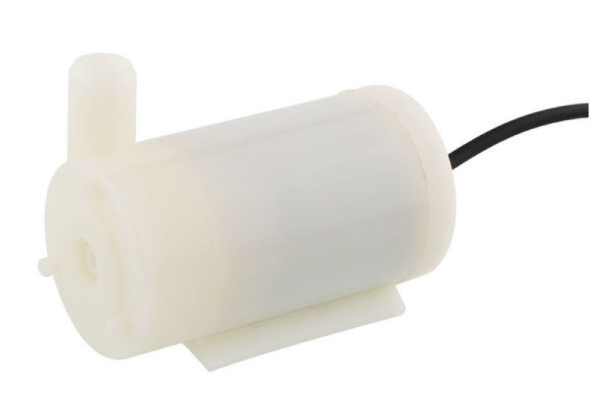
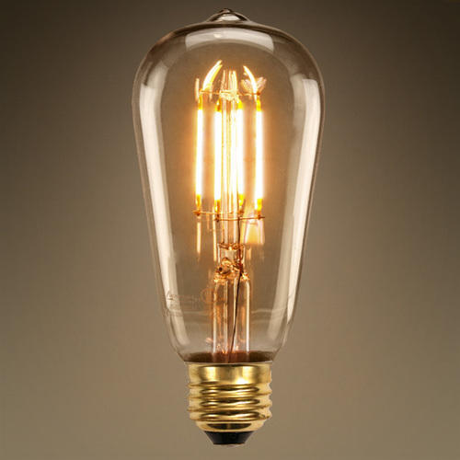
Components
Submersible Water Pump
This is a low cost mini submersible type water pump that works on DC. Just immerse the pump in water, connect a suitable pipe to the outlet and power the motor with to start pumping water.
Incandescent light Source
An incandescent light bulb, incandescent lamp or incandescent light globe is an electric light with a wire filament heated until it glows. The filament is enclosed in a glass bulb with a vacuum or inert gas to protect the filament from oxidation.

Slide 11
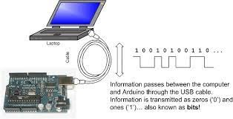
System Software
The Software requirements of the project are
(i) ARDUINO IDE
(ii) PROTEUS SOFTWARE
(i) ARDUINO IDE
An Arduino board consists of an Atmel 8-bit AVR Microcontroller with complementary components to facilitate programming and incorporation into other circuits.

Slide 12
(ii) PROTEUS SOFTWARE
The Proteus Design Suite is a protected software tool suite used primarily
for electronic design automation. The software is used mainly by electronic design
engineers and technicians to create schematics and electronic prints for
manufacturing printed circuit boards.
Proteus Software consists of
Schematic Capture
Microcontroller Simulation
PCB Design

Slide 13
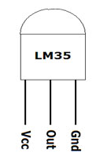
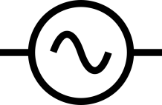
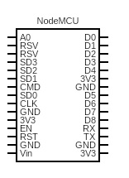
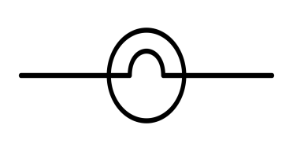
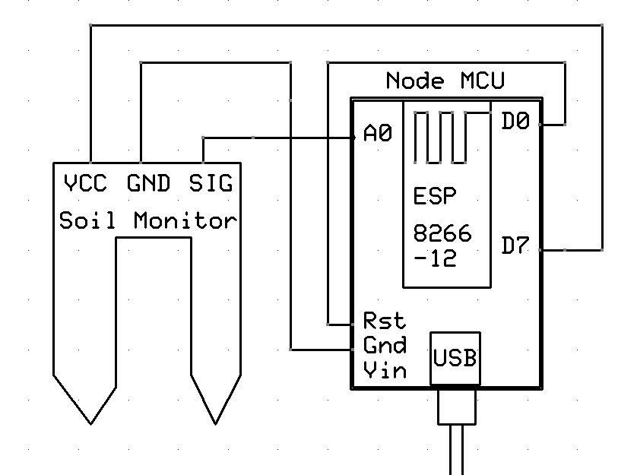
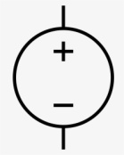
Circuit Diagram
Dimmer module
Relay
Relay
Watering System
Air conditioning system

Slide 14
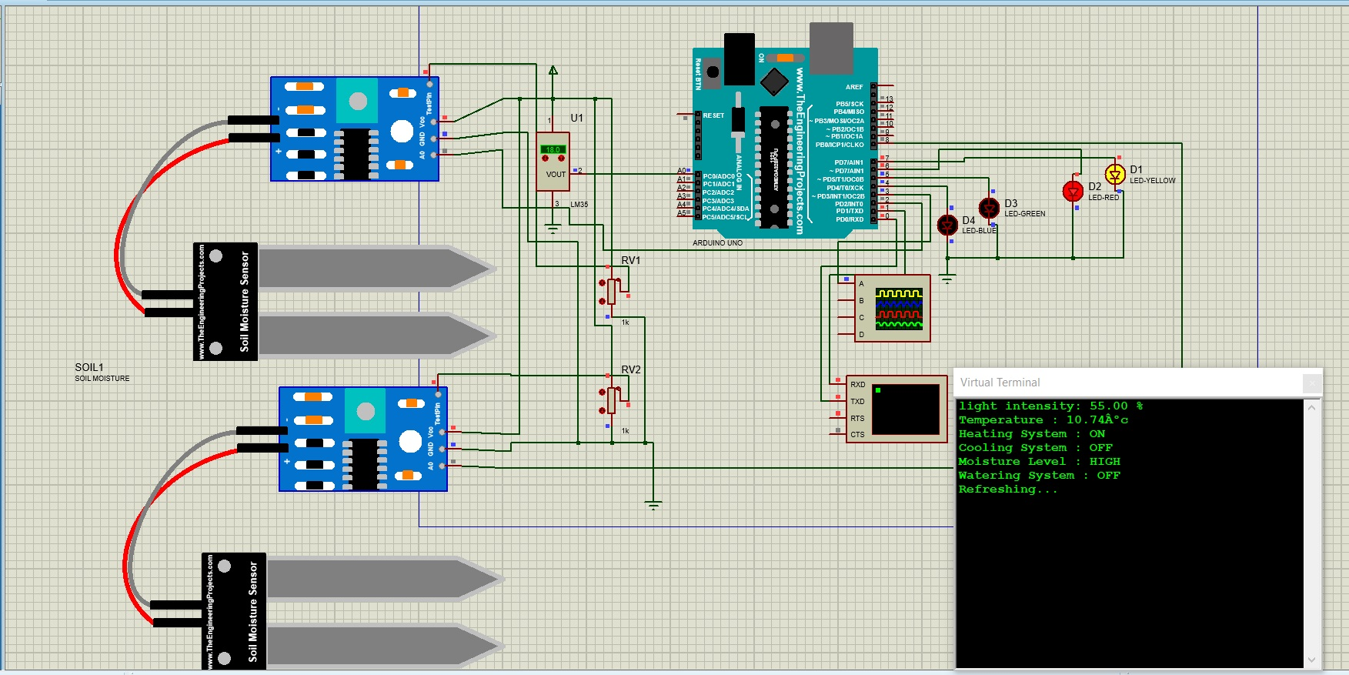
Simulation Results

Slide 15
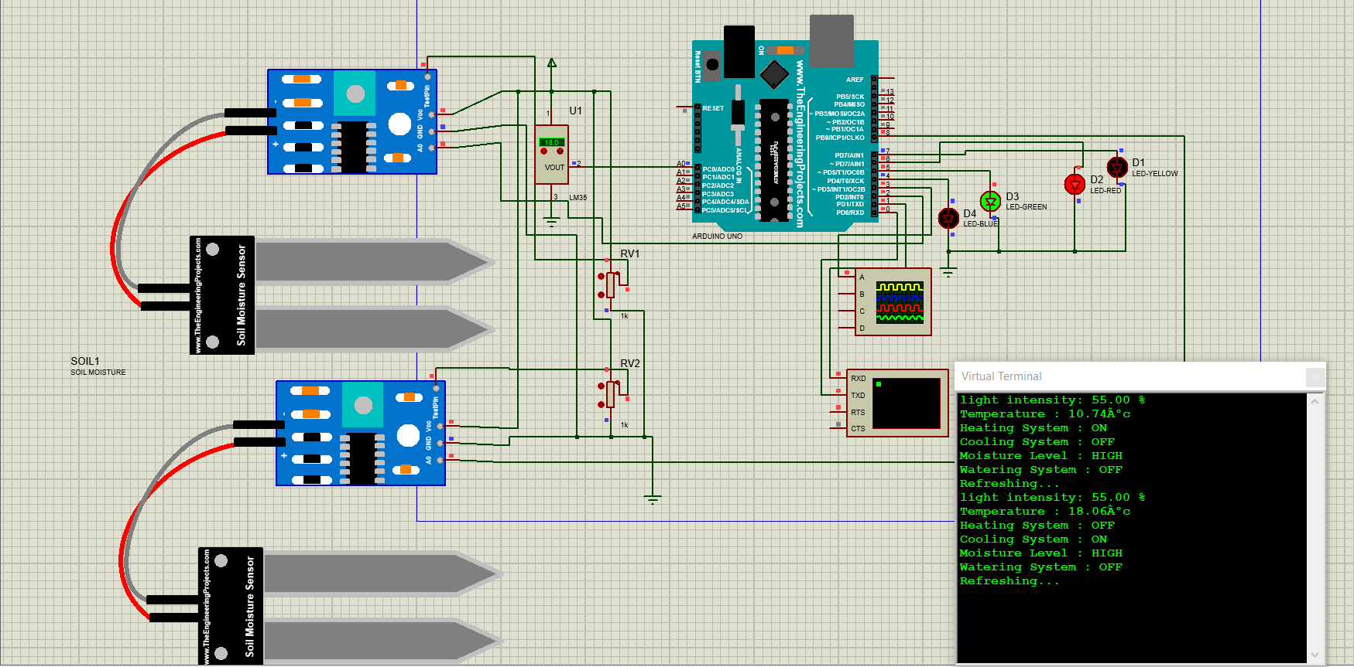

Slide 16
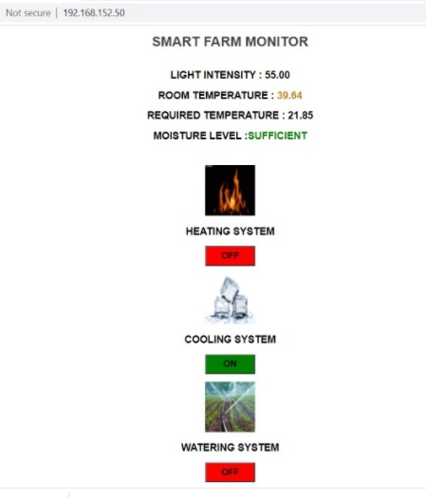
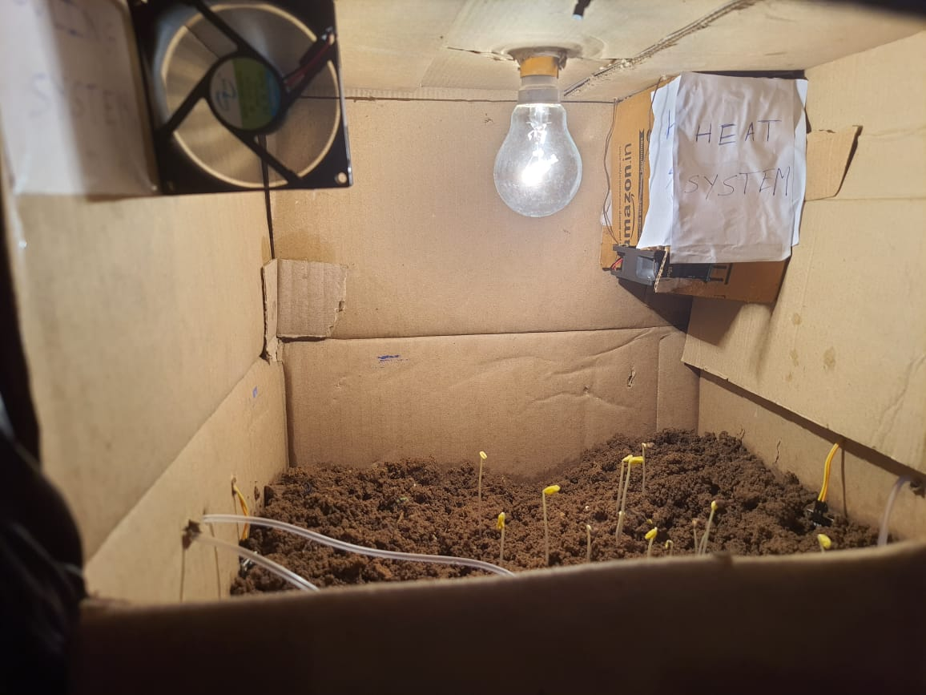
Real Time Results
At starting stage :

Slide 17
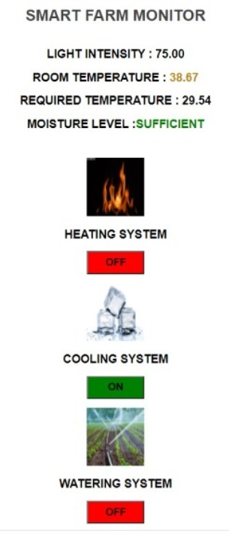
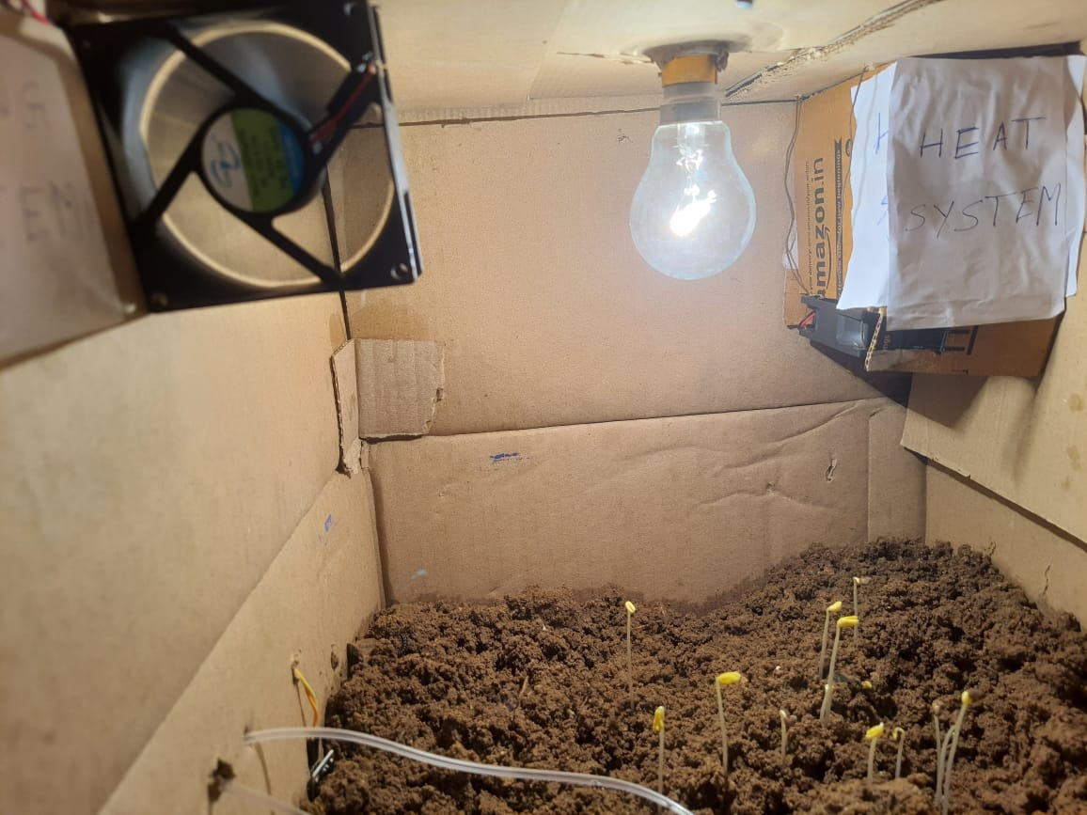
At 3 hours:

Slide 18
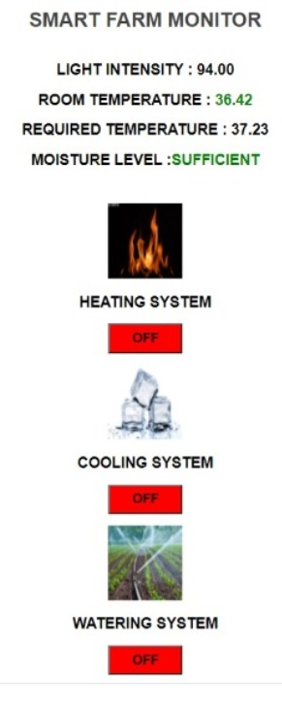
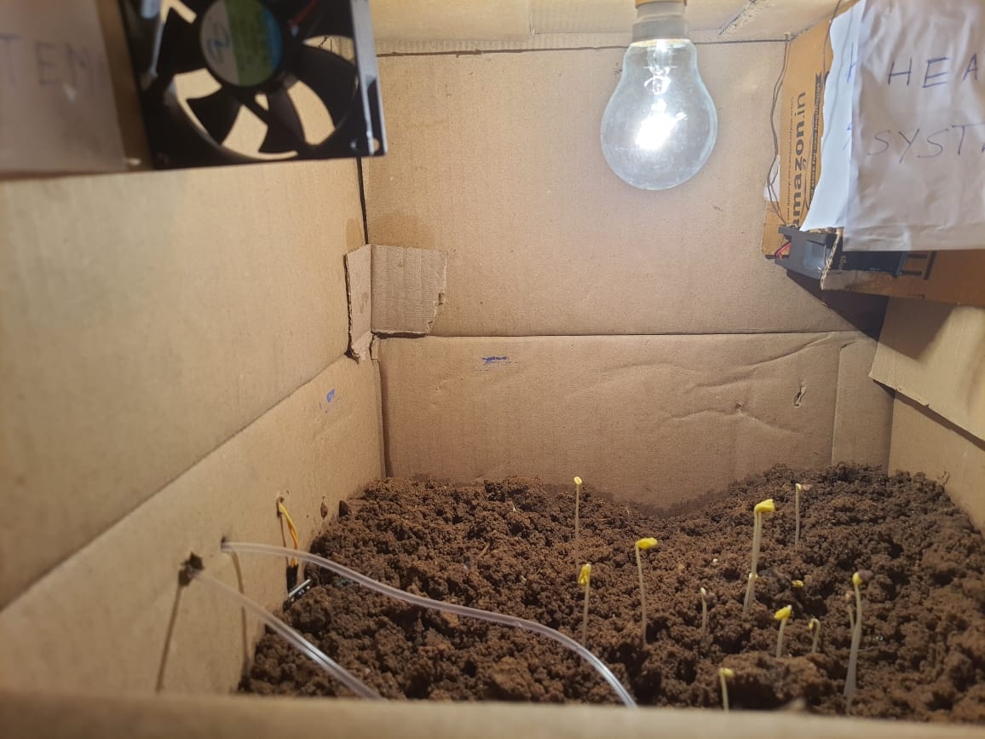
At 6 hours:

Slide 19
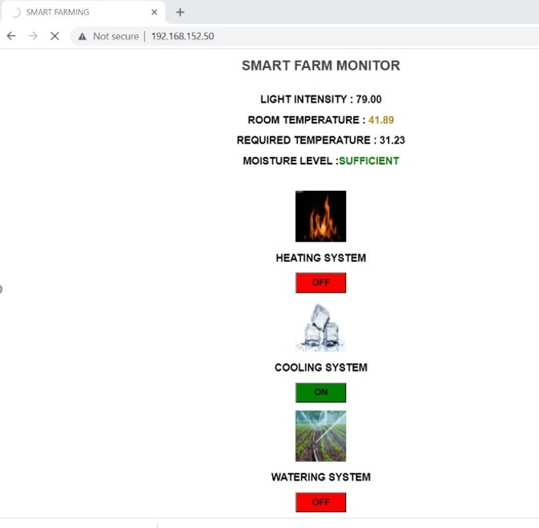
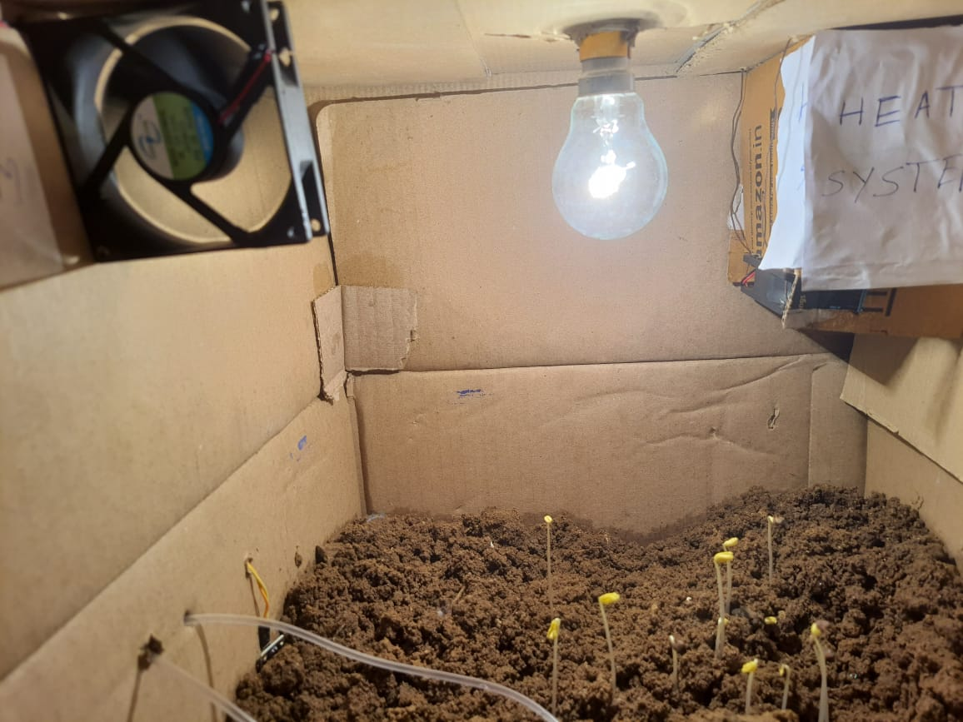
At 15 hours:

Slide 20
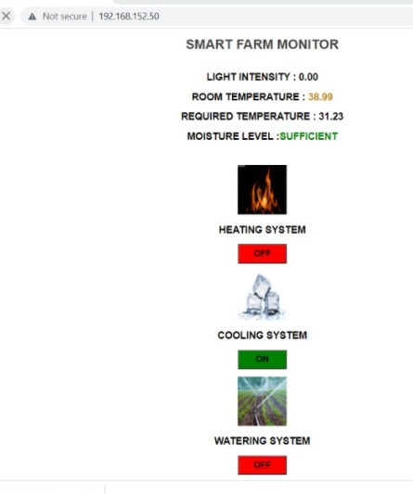
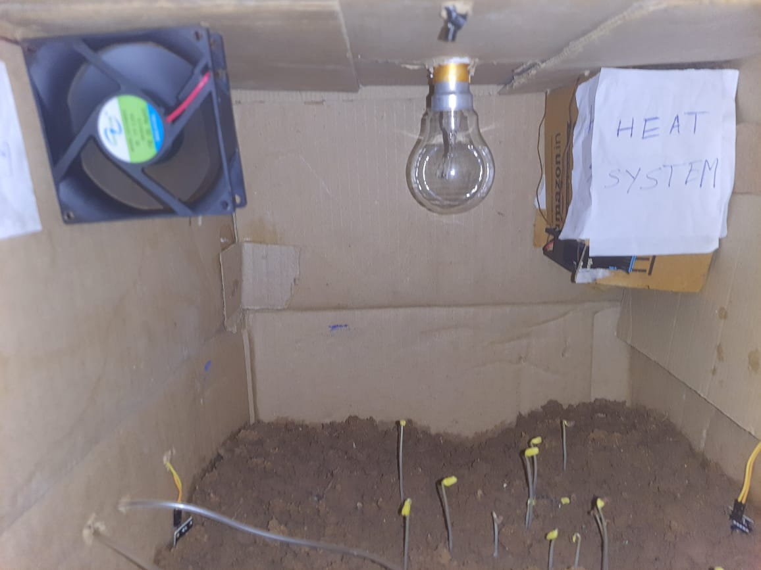
At 21 hours:

Slide 21
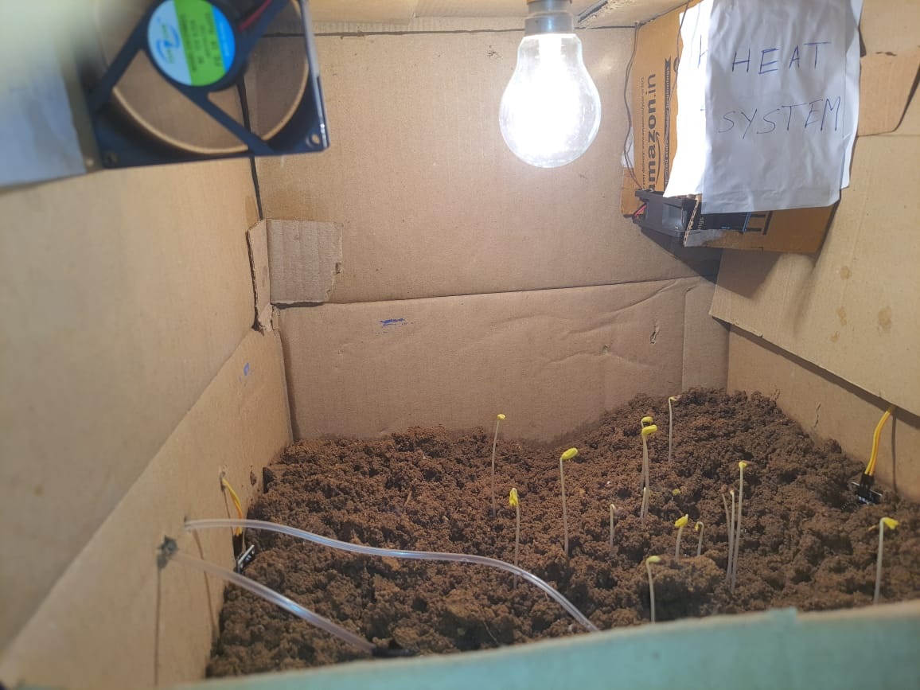
At 25 hours:

Slide 22
Conclusion
Thus, by doing this project, to develop a smart system that can measure and record the temperature, soil moisture, light intensity and provides water depending on soil moisture without any human intervention in indoor environment. It also helps in increasing food production and also makes sufficient use of water without wasting water.
Indoor Farming can operate in urban areas as they need far less space compared to traditional farming to operate.
The System has high efficiency and accuracy in fetching the live data of temperature and soil moisture this report will assist in increasing the agriculture yield and take efficient care of food production

Slide 23
Future Scope
Future work would be focused more on increasing sensors on this system to fetch more data in this system to enhance this Agriculture IoT Technology to full-fledged Agriculture Precision ready product
Agriculture automation can be amalgamated with future agriculture systems such as hydroponics, aeroponics or aquaponics.
We can also add some Fault alarming systems to check whether the system is working properly or not .Cloud Computing Technology can also be added to the IoT technology in agriculture which results some additional advantages.
Thus it will make system more automatic. Distance of communication between server and client can be increased using internet.

Slide 24
References
“VerticalFarming”2016[Online].Available: https://en.wikipedia.org/wiki/Vertical_farming
Dr.Dickson.Despommier.” Vertical farming takes root in urban environments”.https://www.allianz.com/en/about_us/open.know ledge/topics/environment/articles/110 601-vertical-farmingtakes-root-in-urban-environments.html/, June 01, 2011
“IoT : Internet of Things”2016[Online].Available : https://en.wikipedia.org/wiki/Internet_of_Things
Dave Evans (April 2011). "The Internet of Things: How the Next Evolution of the Internet Is Changing Everything" (PDF). Cisco. Retrieved 15 February 2016.

Slide 25
THANK YOU

